Slide 1

Sprint Review & Sprint Planning
Dev Naganoolil, Muhammad Zaharudin, Muhammad Zuhaimi, Aryan Mainkar

Slide 2

What We Did?
Finalized Team
Decided on project Idea
FindMyCovid
Worked on Project Charter

Slide 3


Slide 4
Who Did What?
Dev Naganoolil
Problem Statement, Value Proposition, Roles and Responsibilities, Assumption, Team Logo
Muhammad Zaharudin
Background, Related work, Constraints, Risks, Project name
Muhammad Zuhaimi
Cost Proposal, Methodology
Aryan Mainkar
System Overview, Documentation & Reporting

Slide 5
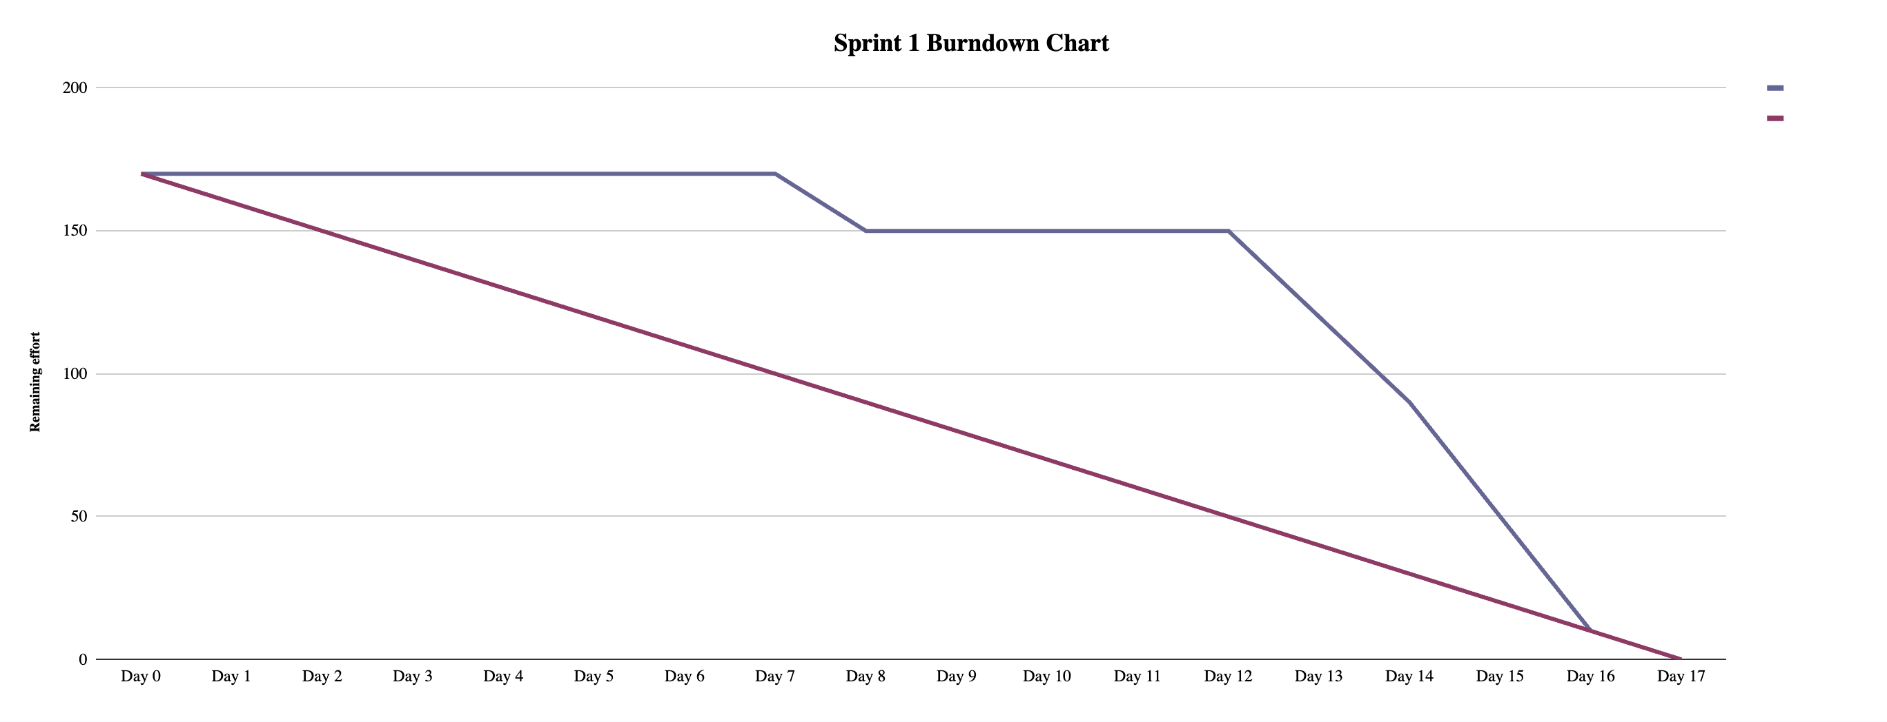

Slide 6
What We Will Work On
Finish Project Charter Document
Do Research On
Api
Database
Trends
Tech Stack

